Slide 1
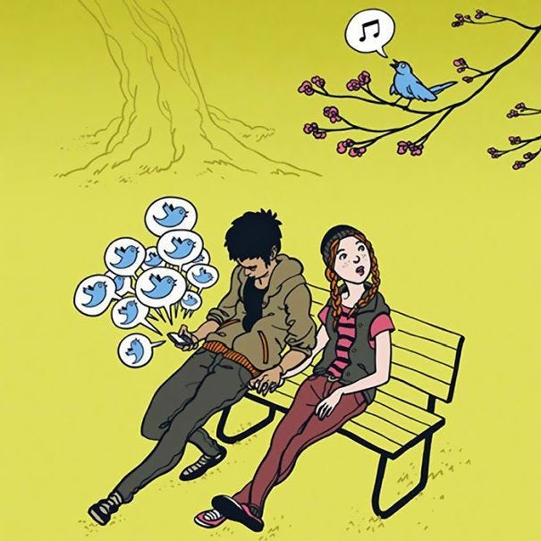
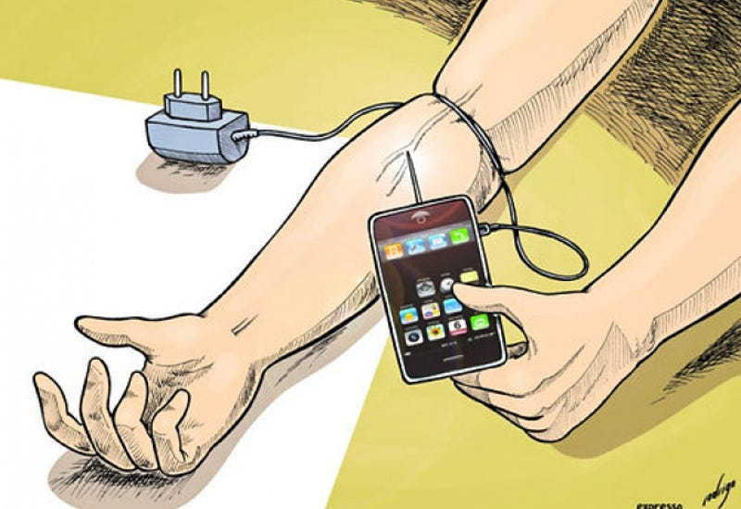
THE USE OF SOCIAL MEDIA BY ADF MEMBERS
By OFFCDT XJA Longo and OCDT J R Dunk

Slide 2

SECURITY WARNING!!!!
No Photos allowed 🔮
THIS BRIEF IS CLASSIFIED AS….
TOP SECRET OFFICIAL SENSITIVE PERS PRIVACY COMPARTMENTALISED

Slide 3
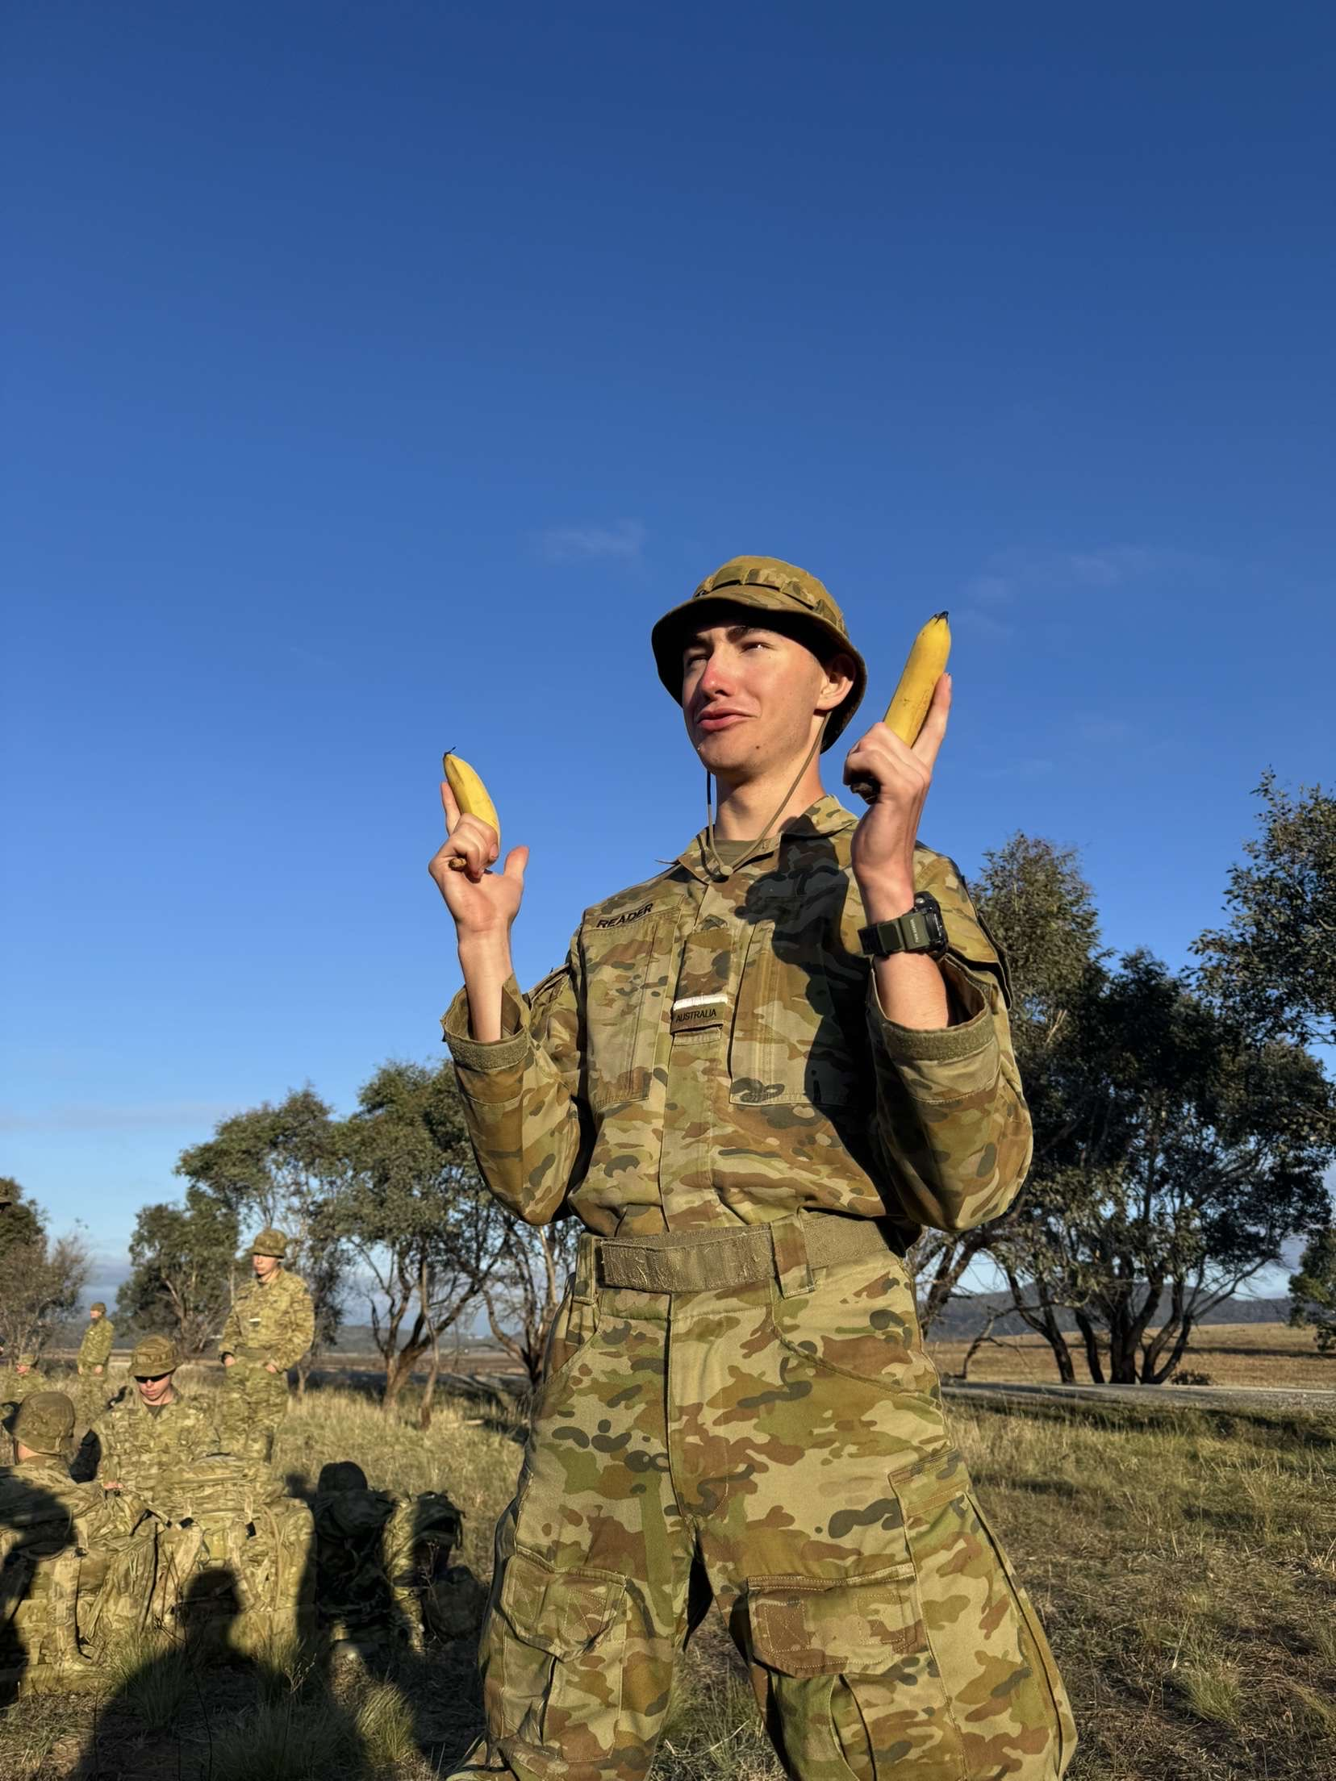
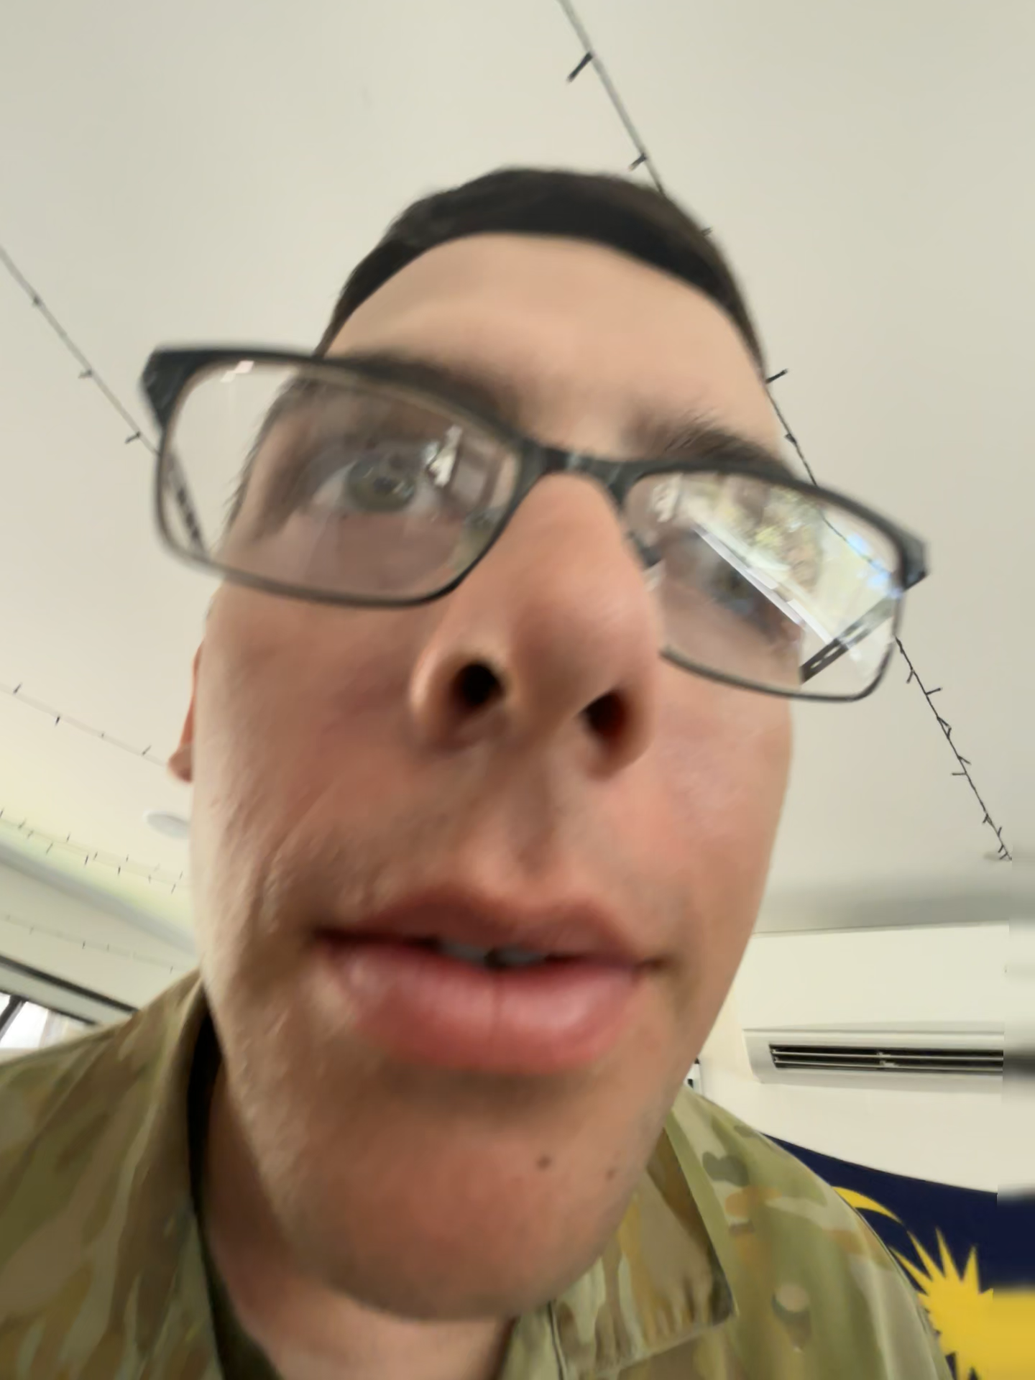
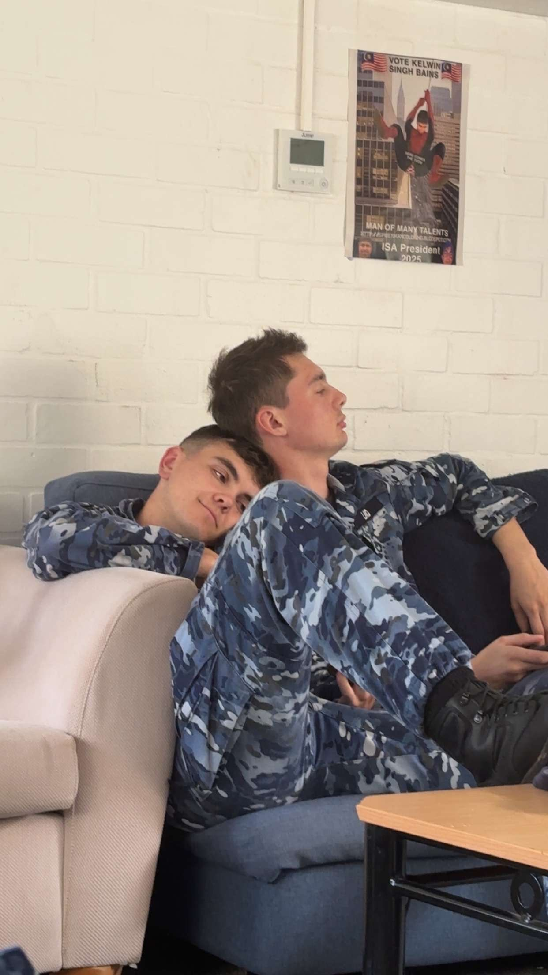
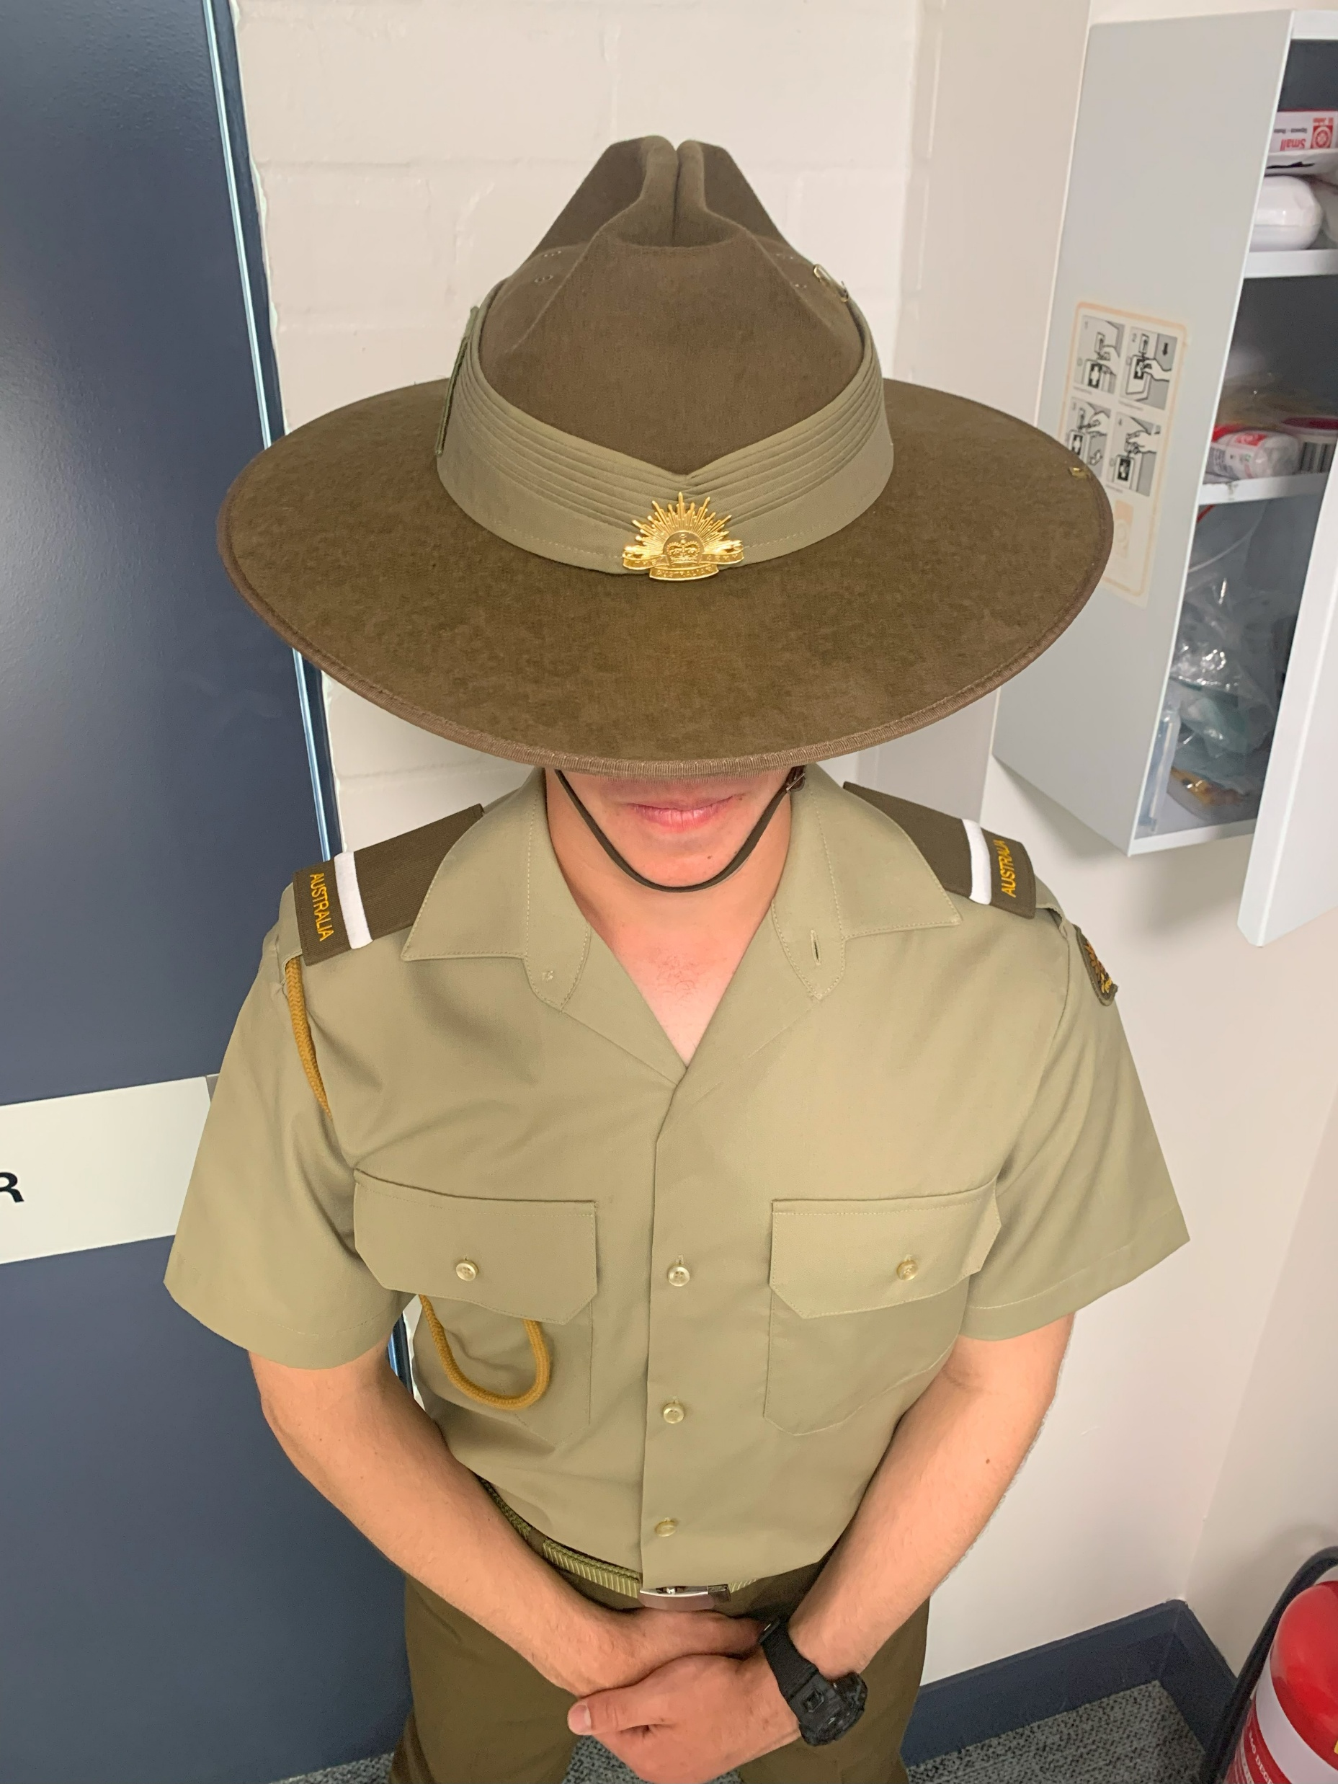
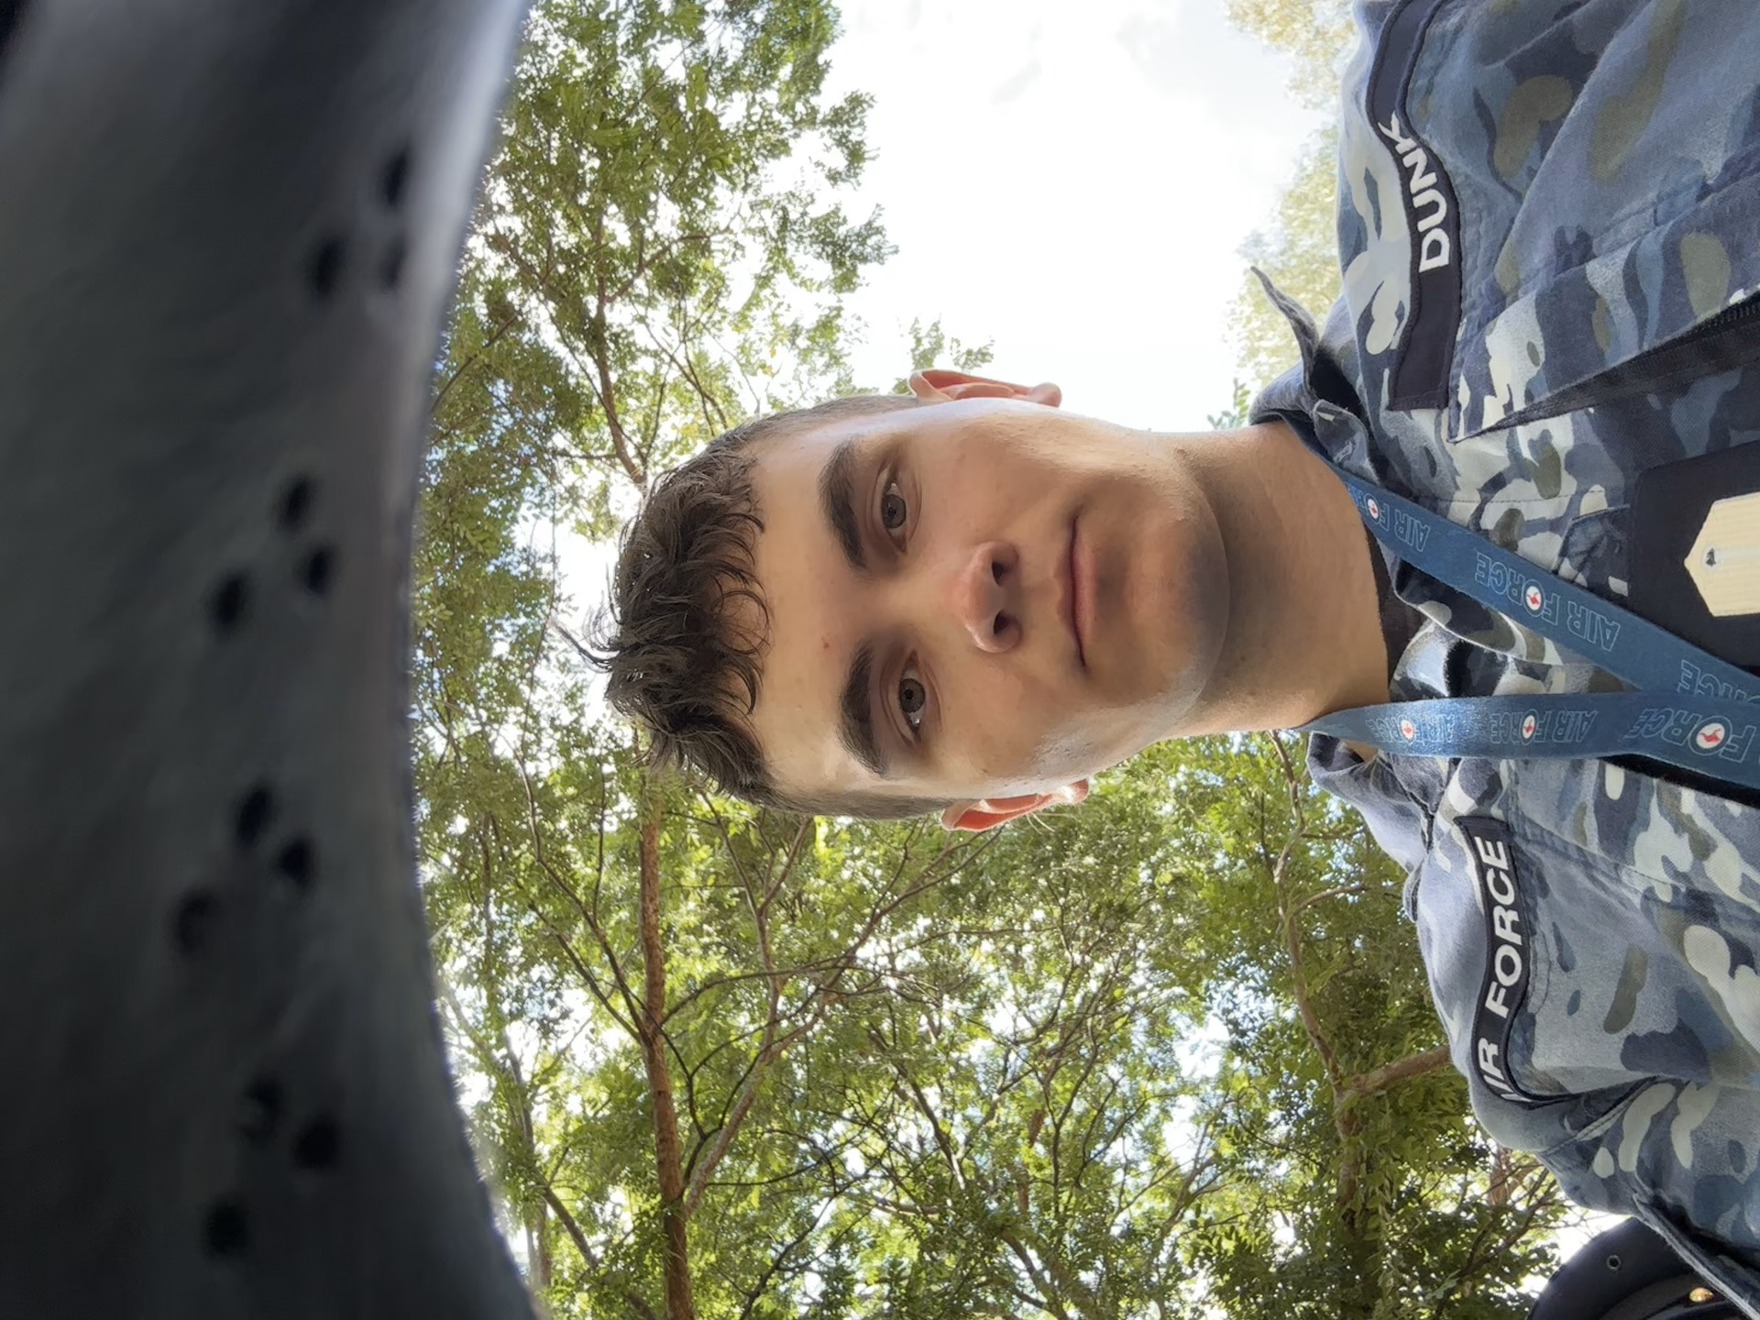
Our Credentials
Why are we qualified to give this brief?
1. Jake and I hold a Diploma in Social Media Studies – Major in Prejudicial Conduct (C1)
2. We post on Social Media
3. We take photos
4. We Did hard Time in prison (ROPS) 4 years (4 days)

Slide 4
Why Posting photos in uniform on SOCIAL Media is bad ☹
**Why Posting Photos in Uniform on Social Media Is Problematic for the Australian Defence Force (ADF) and the Organisation:** Posting photos in uniform on social media may appear harmless at first glance—an act of pride, patriotism, or camaraderie. However, for the Australian Defence Force (ADF), it presents a range of operational, security, reputational, ethical, and legal challenges. This comprehensive analysis explores why such behaviour, if not controlled, can be detrimental to both individuals and the wider organisation. **Operational Security (OPSEC) Risks** One of the most serious risks associated with posting photos in uniform is the violation of operational security. Uniformed personnel may unintentionally reveal sensitive information such as unit locations, deployments, military assets, base layouts, or ongoing operations. Geotags, backgrounds, or even seemingly trivial visual details can be exploited by adversaries—including state and non-state actors—to track movements, identify targets, or infer patterns of operation. For example, a single photo showing a recognisable background, timestamp, or weapon system might allow foreign intelligence services or terrorist organisations to gather actionable intelligence. Even if the individual thinks the content is benign, the aggregation of small details across social media platforms can lead to a significant intelligence compromise. ### 2. **Personal Safety and Targeting** Wearing the uniform in social media posts makes personnel easily identifiable as members of the ADF. This can place them and their families at risk, especially from hostile actors or ideologically motivated groups. Unlike traditional warfare, modern conflict includes cyber and information warfare tactics, where individual service members can become targets of online harassment, doxxing, blackmail, or threats. Photos in uniform may be reverse-searched to locate personal details, home addresses, or social affiliations, exposing members and their loved ones to risk. Moreover, in areas of high domestic or geopolitical tension, a visible association with the military may draw unwanted or dangerous attention in both physical and digital spaces. **Breach of Defence Policies and Code of Conduct** ADF policy clearly outlines expectations regarding professional conduct, including the use of social media. Posting in uniform may breach Defence Instructions (General) (DIGs) and Standing Orders that govern how personnel are to present themselves publicly. Members must not act in a way that may bring disrepute to the organisation, undermine public trust, or appear to endorse or criticise political, commercial, or social positions while in uniform. Uniformed photos posted online can blur the line between private and official communication. For example, a captioned photo might unintentionally associate the ADF with a political statement, protest, or controversial social issue—thus violating the ADF’s apolitical stance. Even neutral or humorous posts can be taken out of context, distorted, or weaponised by hostile media outlets or political actors.### 4. **Reputational Risk to the ADF**Every member of the ADF is, by default, a public ambassador of the organisation. Posting photos in uniform gives the impression that the individual is speaking or acting on behalf of the ADF, whether intended or not. Inappropriate behaviour, language, or affiliations—even if unrelated to Defence activities—can quickly become a scandal when posted in uniform.There have been numerous cases internationally where uniformed selfies, TikTok dances, or controversial opinions went viral and caused significant damage to public trust in military organisations. These incidents can lead to public backlash, media scrutiny, and loss of confidence in Defence leadership and culture. ADF personnel are held to a higher standard than civilians, particularly in public-facing environments. Missteps can be interpreted as signs of poor discipline, lack of professionalism, or cultural dysfunction—undermining recruitment efforts, morale, and public funding support. **Impersonation and Misinformation Risks** Photos of ADF members in uniform can be manipulated or stolen to impersonate service personnel. Scammers frequently use military identities on social media and dating platforms to defraud unsuspecting civilians. When real service members post in uniform, they may unwittingly provide material for these fraudulent activities. Additionally, in the information warfare environment, adversaries can use such images to spread disinformation. A doctored image of an ADF member allegedly involved in a controversial activity—supported by a real photo in uniform—can lend credibility to fake narratives, damaging Australia’s reputation internationally.**Cultural and Ethical Considerations**Posting in uniform may conflict with Defence values such as humility, professionalism, and teamwork. It can come across as self-aggrandising or individualistic in a profession that emphasises unity and selfless service. Defence culture expects members to avoid drawing undue attention to themselves or personal achievements, especially in contexts where they represent more than just themselves.There is also a growing concern about "performative patriotism" or “uniform clout”—where personnel post in uniform for likes, validation, or influencer status. This behaviour undermines the seriousness of military service and dilutes the meaning of the uniform, which is earned, not accessorised. It may foster resentment among peers and erode esprit de corps.**Legal and Administrative Consequences**Posting in uniform on social media can result in disciplinary action under the Defence Force Discipline Act (DFDA) or administrative sanctions, including counselling, loss of promotion opportunities, or discharge. For example, if a member is found to have violated Defence social media policies, brought discredit upon the service, or revealed sensitive information, they may be subject to investigation and punishment. In some cases, the breach could lead to criminal prosecution if national security is compromised or if the content violates privacy laws, defamation laws, or anti-discrimination legislation.**Impact on Cohesion and Command** Visible self-promotion on social media in uniform can affect unit cohesion, hierarchy, and command authority. Junior members may gain disproportionate public attention or online influence, potentially undermining senior leadership or formal channels of communication. It may also lead to comparisons, jealousy, or in-group/out-group dynamics, which negatively affect team cohesion. Commanders may be forced to address public incidents involving their subordinates, redirecting time and resources away from operational readiness. This additional burden reduces the effectiveness and focus of the team, particularly in high-tempo or sensitive environments. Social media posts in uniform can confuse the line between an individual’s military identity and civilian persona. While Defence members are entitled to private lives, the public nature of platforms like Instagram, TikTok, and Facebook means their military association becomes visible and searchable—permanently. This visibility can conflict with civilian employment, education, or advocacy roles. It may also create tension in a pluralistic society where Defence must remain politically neutral and inclusive. Public debates or commentary made by individuals in uniform—even in off-duty contexts—can wrongly be interpreted as institutional opinions. *Undermining Australia’s International Standing** Photos in uniform, when taken out of context, can harm Australia’s diplomatic relationships, especially in multinational operations. Partner nations may interpret behaviour differently or hold higher expectations about online decorum. A controversial or disrespectful image of an ADF member in uniform overseas may be seen as offensive or unprofessional, straining alliances or coalition dynamics. Moreover, adversaries may use such content to question Australia’s military professionalism, ethics, or cultural maturity in forums like the UN, international media, or cyber campaigns. Conclusion In summary, posting photos in uniform on social media poses multiple risks for the Australian Defence Force and the individual member. It jeopardises operational security, personal safety, and organisational integrity. It can damage the ADF's public reputation, breach policy and law, and create internal friction. While Defence members are understandably proud of their service, the uniform carries responsibilities that transcend personal expression. As such, restraint, discretion, and strict adherence to Defence social media guidelines are essential. Professionalism must extend to the digital sphere, where every post can have wide-reaching consequences, both intended and unintended. Social media is not a private diary—it is a global platform. In the ADF, the privilege of wearing the uniform comes with the duty to protect not only lives but also the institution's trust, discipline, and reputation.

Slide 5
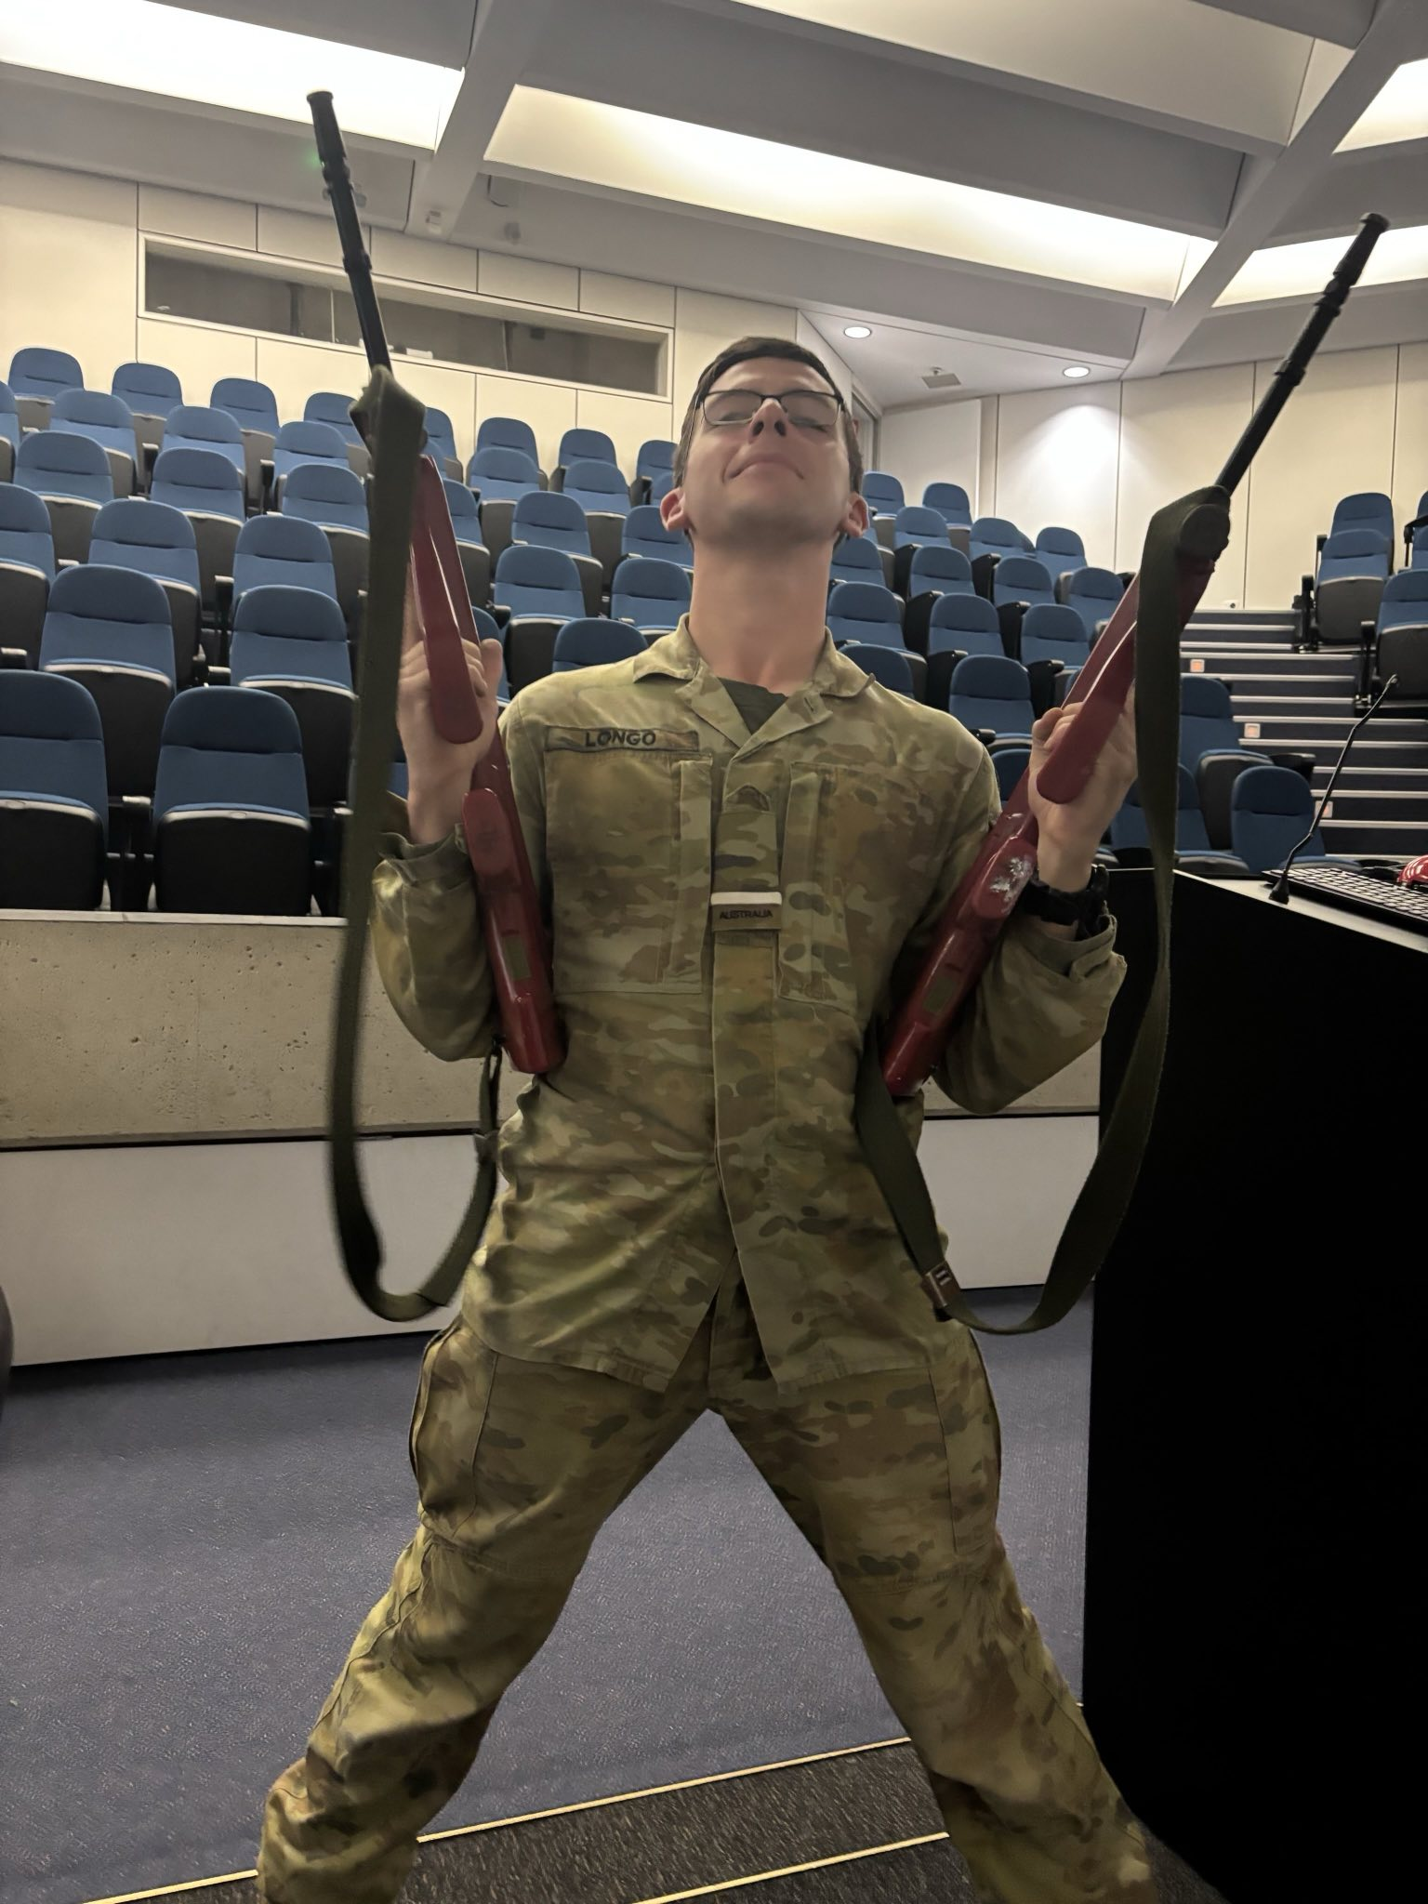
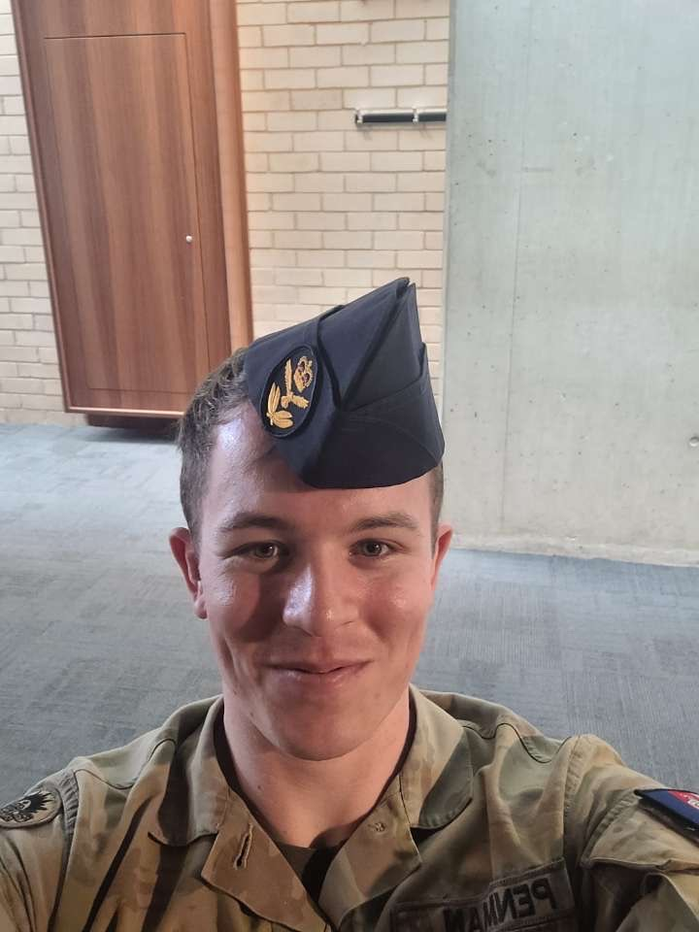
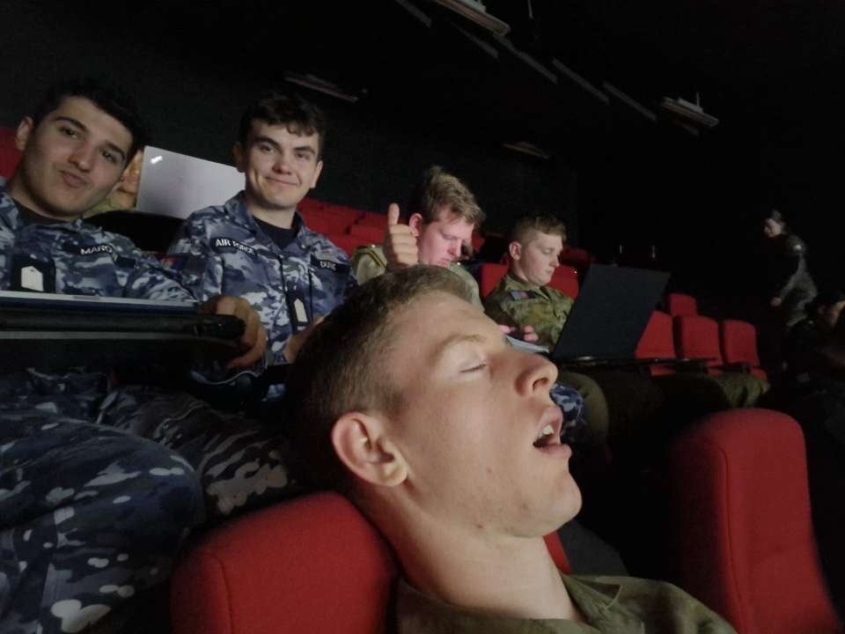
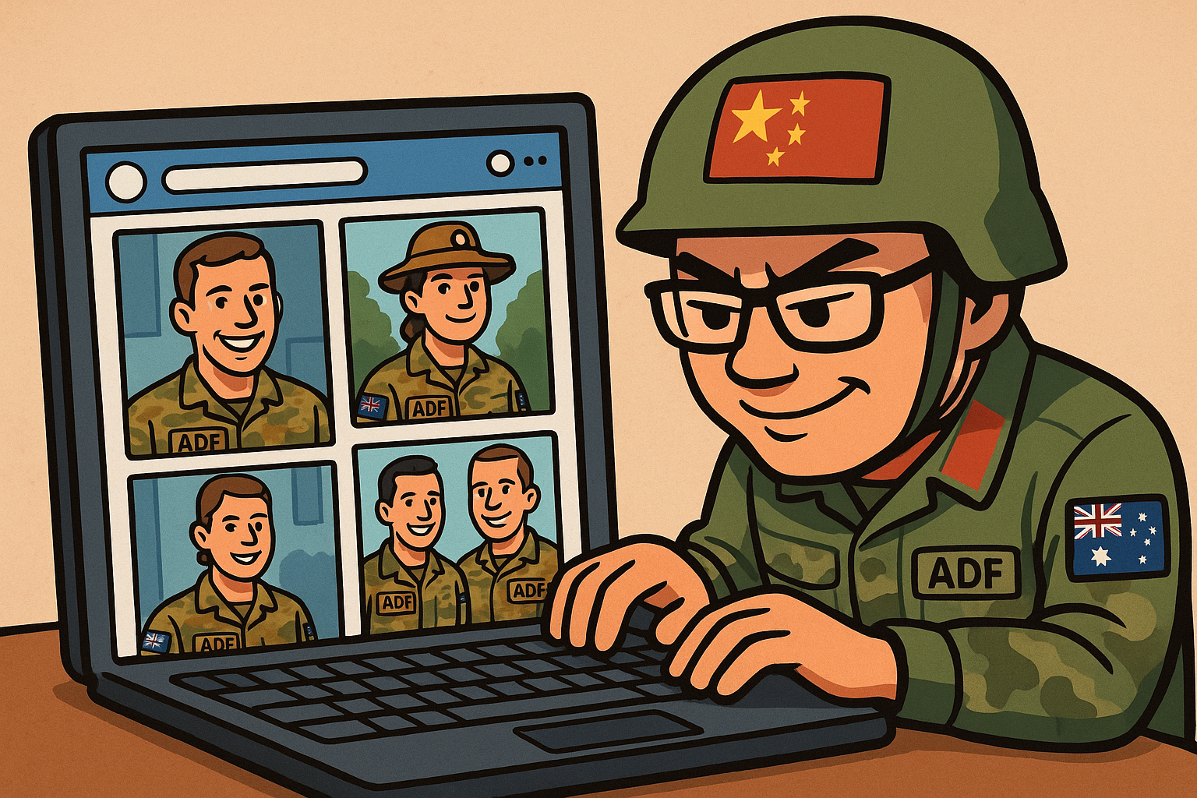

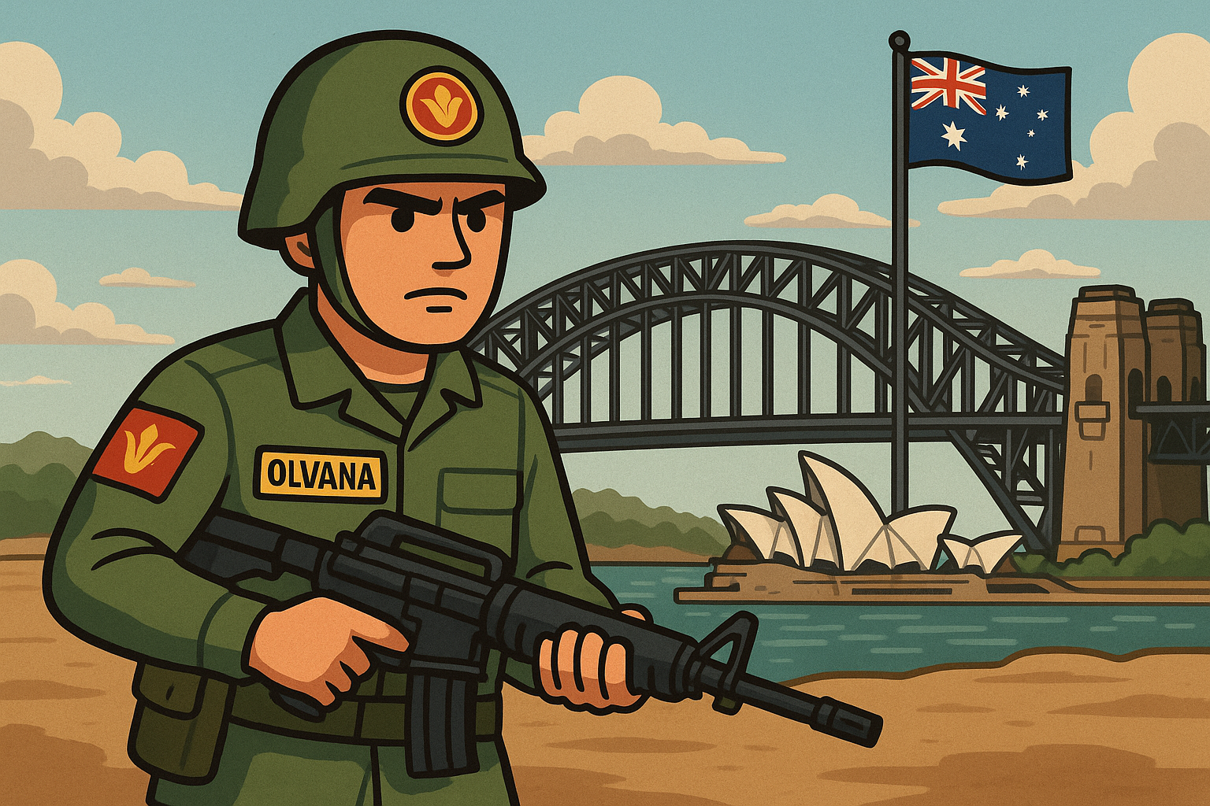
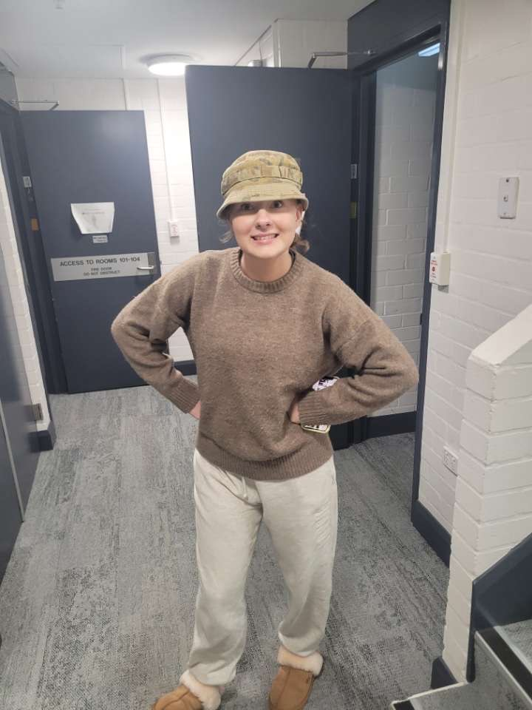
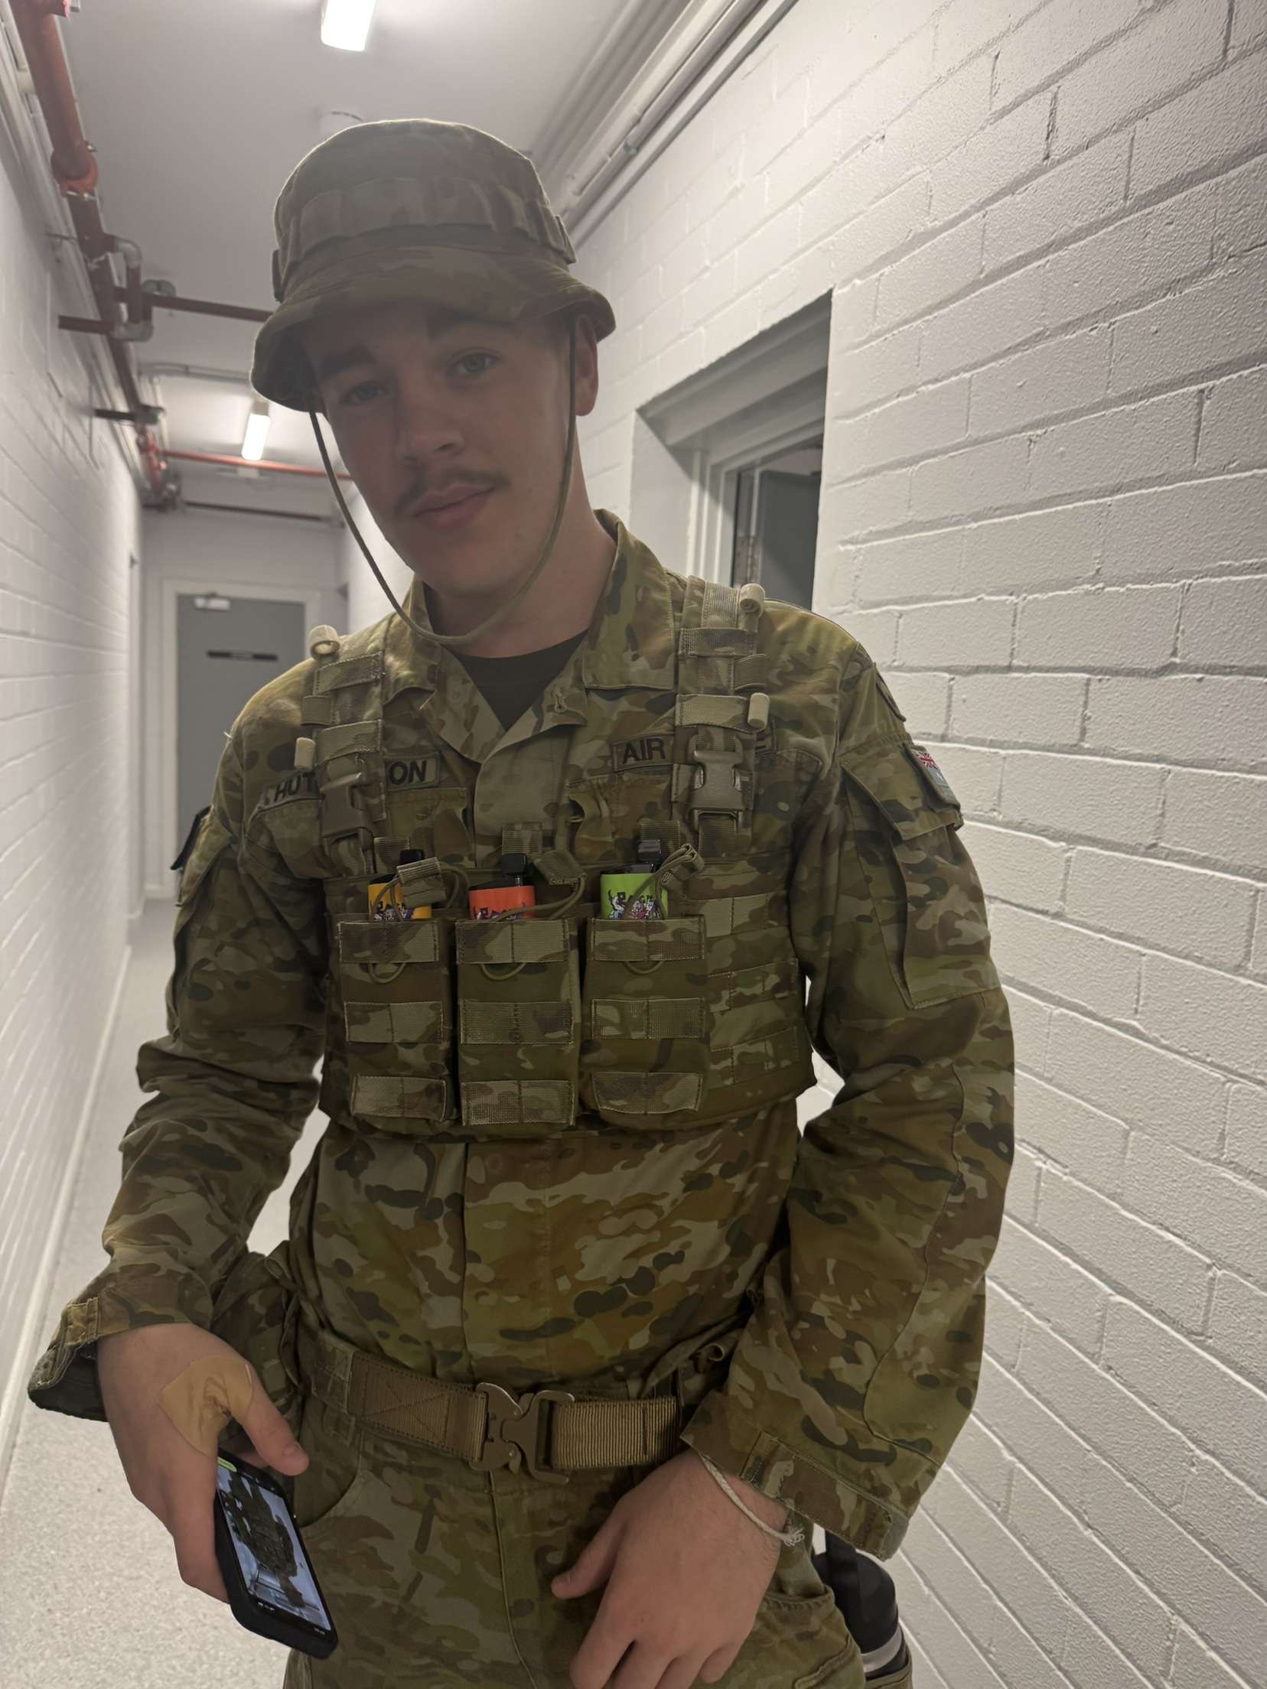
How Posting photos in uniform can lead to the Defence of Australia and Australia’s Soft power being degraded in such a way that eventually leads to a certain nation state to our North invading *cough cough China Olvana

Slide 6

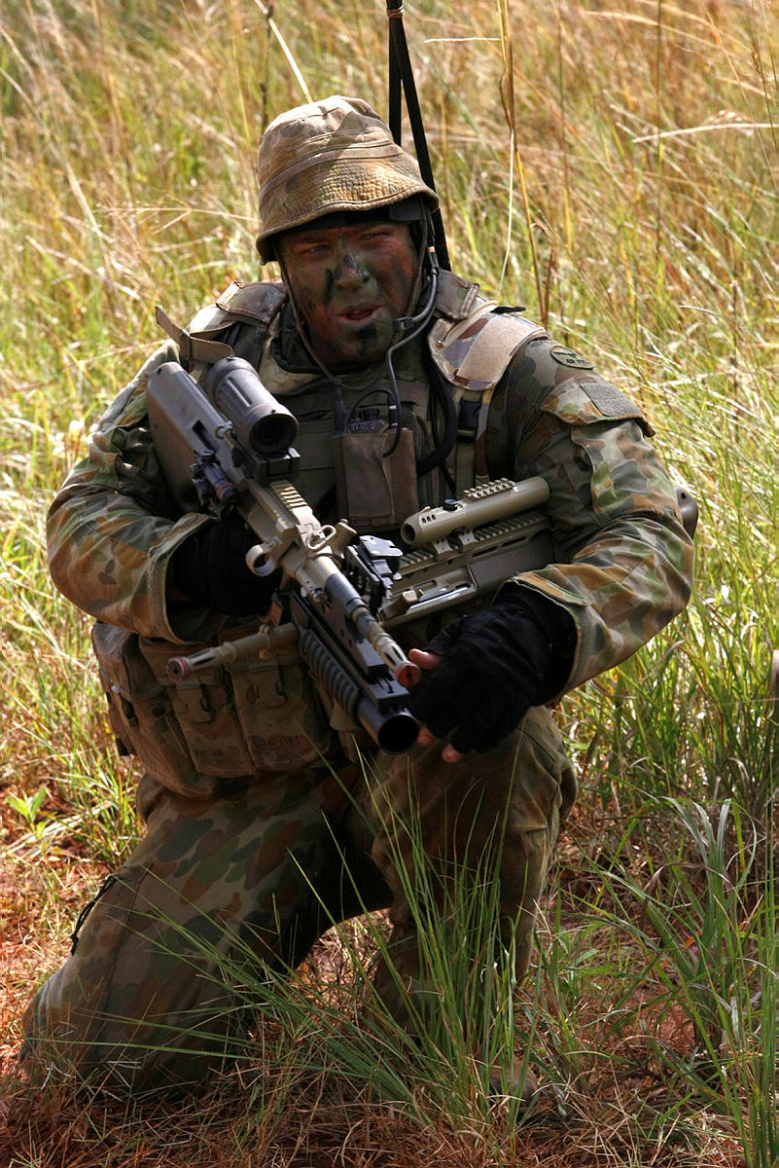
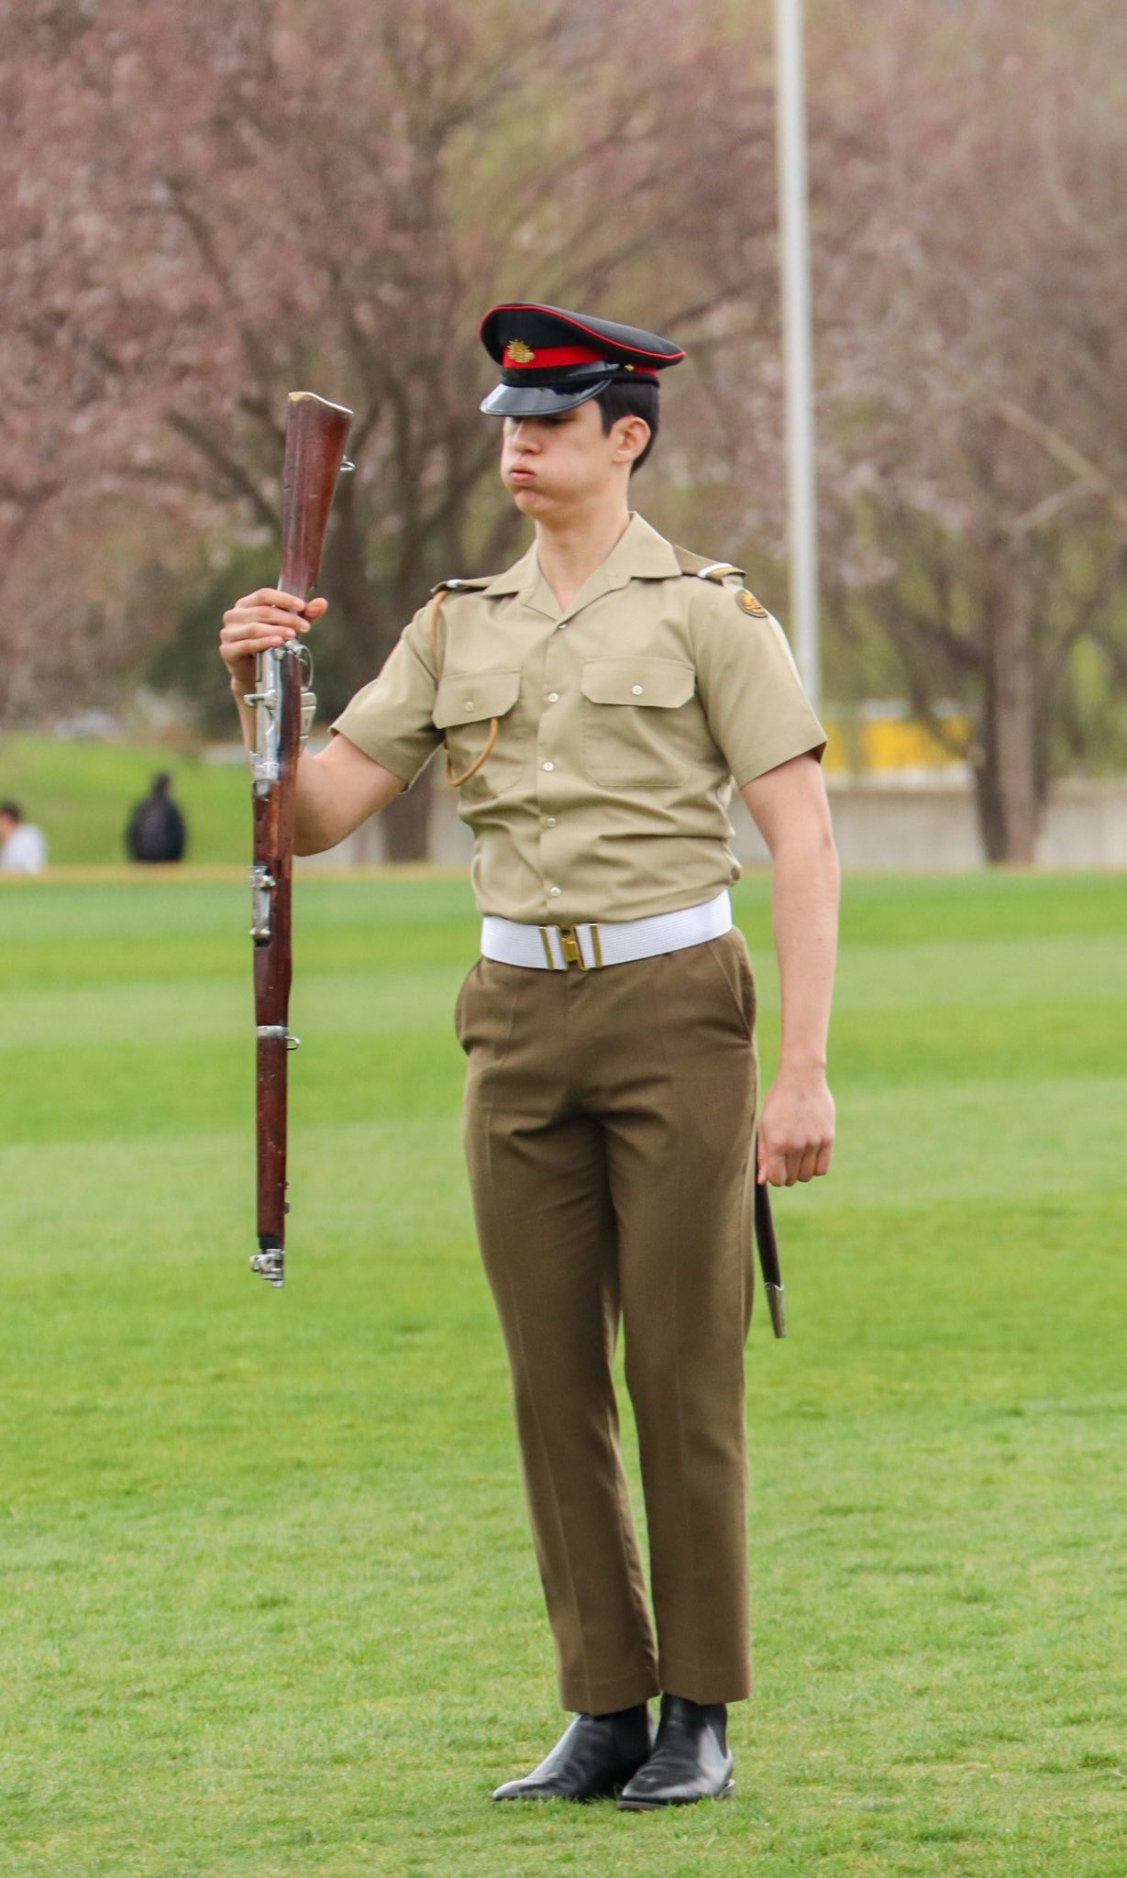
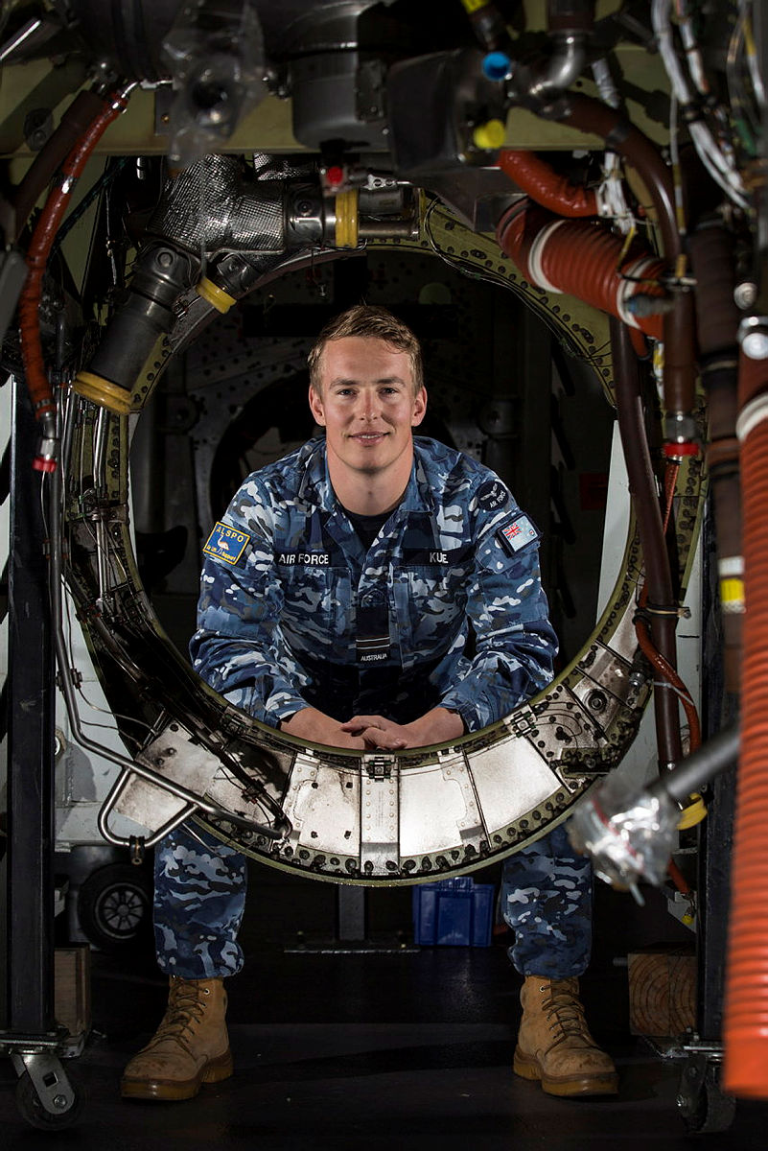
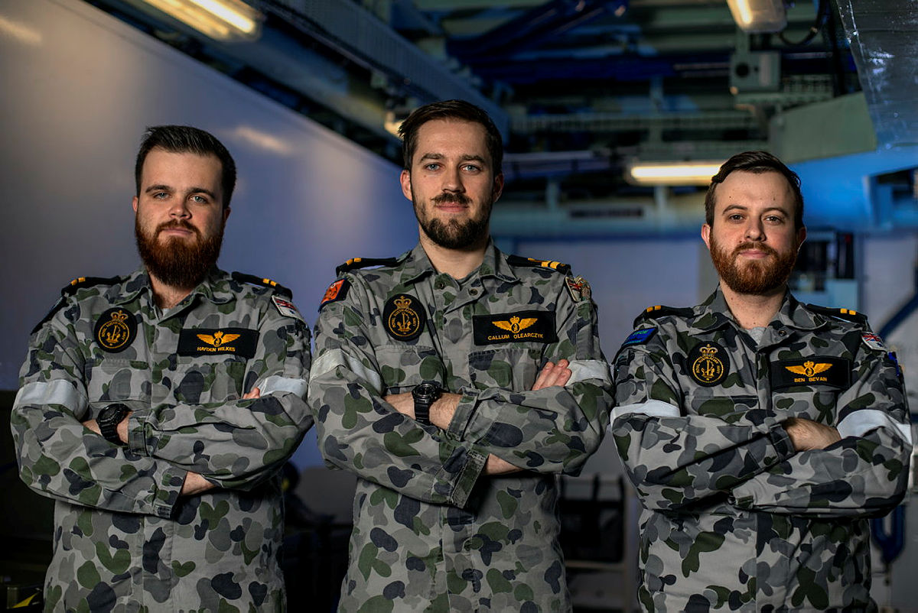
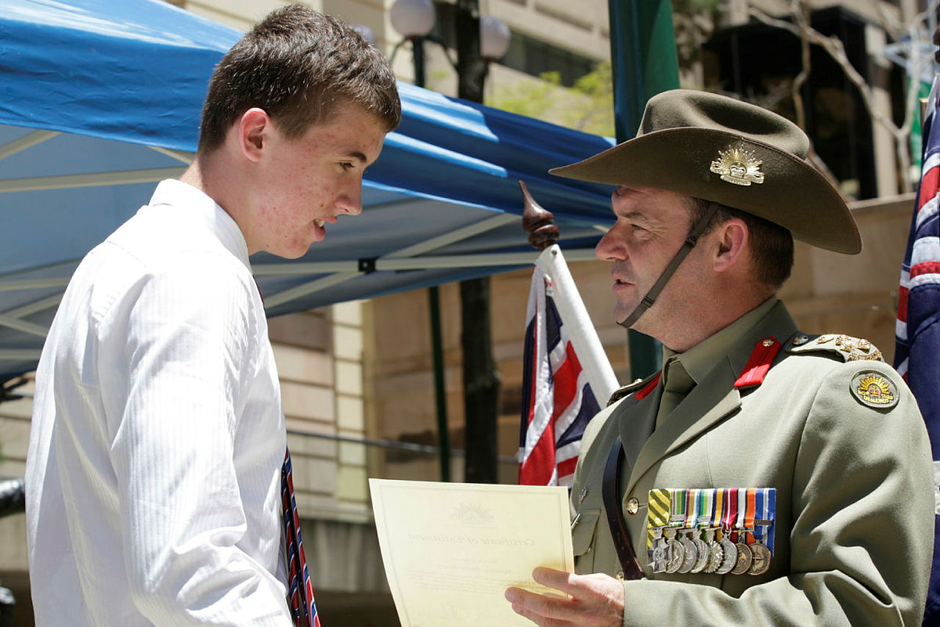
Remember….
Not All photos in uniform are bad…
Only post images released by Defence…

Slide 7
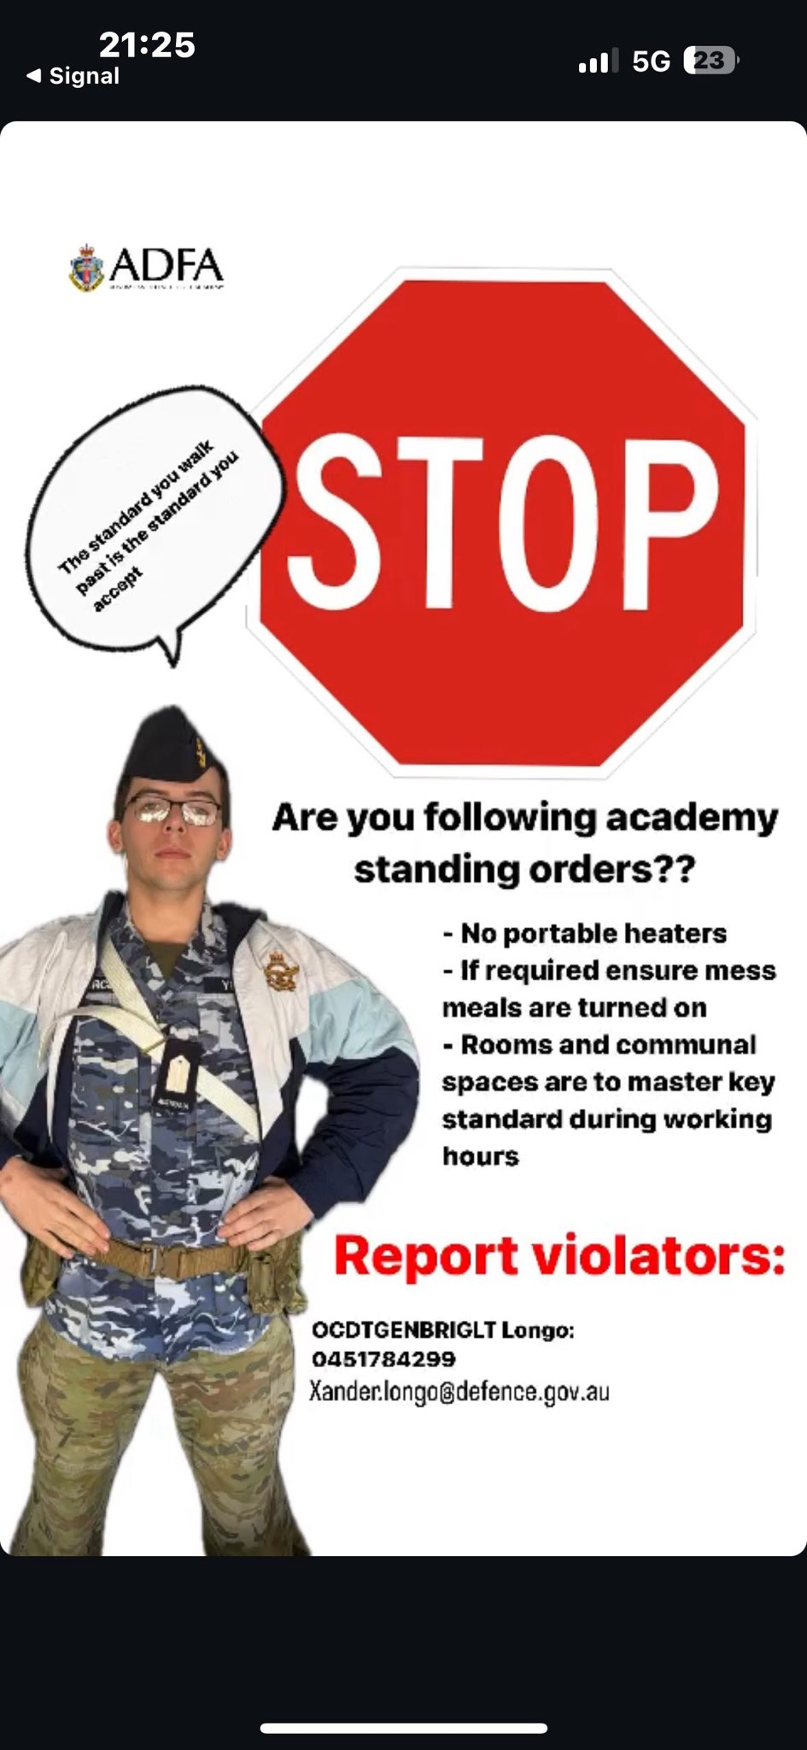
KEY TAKEAWAYs
Taking photos in uniform without proper approval = bad
Posting said photos is also bad
IF you are posting ensure it is IAW
Defence Values,
MILPERSMAN,
DFDA 1982,
ESPIONAGE ACT 1917,
Criminal Code Act 1995 (Cth) and
ADFA SO’s
Defence Force Writing Manual

